Slide 1
Combining Results with UNION Operator
Presented by: Nimra Sultan

Slide 2
Union & Union All operator
Union operator combines the results of two or more queries into a distinct single result-set Which Include all rows available for all queries in the join. In short, it combines two more queries and removes the duplicates.
Union All operator combines the results of two or more queries into a single result-set Which Include all rows available for all queries in the join. In short, it combines the two or more row sets and keeps the duplicates.

Slide 3
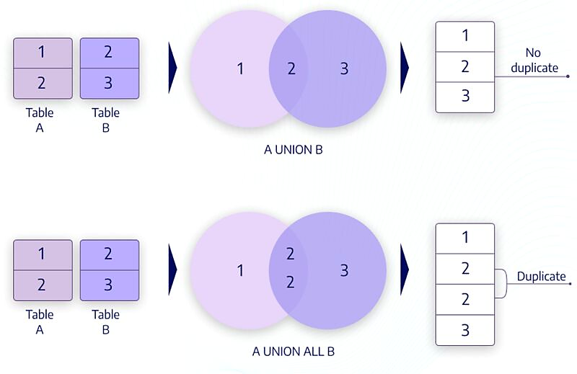

Slide 4
Syntax:
SELECT Column1, Column2, … ColumnN FROM <table> [WHERE conditions] [GROUP BY Column(s]] [HAVING condition(s)] UNION SELECT Column1, Column2, … ColumnN FROM table [WHERE condition(s)]; ORDER BY Column1,Column2…

Slide 5
Rules:
The number of columns present in each query must have the same order.
Datatypes in each SQL statement must match
There may be an ORDER BY clause, but this must be the last statement of the SQL.

Slide 6
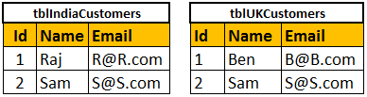
For Example:
Consider India and UK customer tables below:

Slide 7
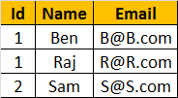
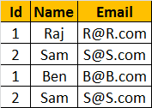
Combining Results with UNION Operator
By combining the result set using UNION
By combining the result set using UNION ALL
Select Id, Name, Email from tblIndiaCustomers UNION Select Id, Name, Email from tblUKCustomers
Select Id, Name, Email from tblIndiaCustomers UNION ALL Select Id, Name, Email from tblUKCustomers

Slide 8
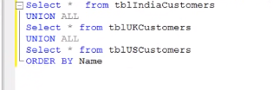

Order By clause should be used on the last SELECT statement to sort the result set

Slide 9
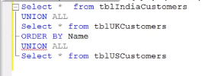

The following query returns a syntax error.

Slide 10
Difference between UNION and UNION ALL
From the output it is clear that UNION removes duplicate rows while UNION ALL does not.
When UNION is used, SQL Server needs to do distinct sorting, which is very time consuming. Therefore, UNION ALL is faster than UNION.

Slide 11
Difference between JOIN and UNION
UNION combines the result-set of two or more select queries into a single result-set which contain all the rows from all the queries in the union.
whereas JOINS, retrieve data from two or more tables based on logical relationships between the tables.
In short, UNION combines rows from 2 or more tables, where JOINS combine columns from 2 or more table.

Slide 12
Summary:
The UNION operator in SQL is used to combine the results of two or more queries into a single distinct result set.
It is one of the set operators in SQL that are used to join the results of two or more SELECT statements.
The UNION operator combines the results of two SELECT statements by removing any duplicates present in the results being combined.
To use the UNION operator, the number of columns being retrieved by each SELECT command, within the UNION, must be the same, and the columns in the same position.
Each SELECT statement must contain matching data. The order of the Columns in the SELECT statement must be correct.
The UNION operator can be used on a single field or multiple fields.
When using the UNION operator, the database system processes the query by executing two SELECT statements first and then combines two individual result sets into one and eliminates duplicate rows.
To retain the duplicate rows in the result set, the UNION ALL operator can be used instead.
The UNION operator is different from the join, as the join combines columns of multiple tables while the union combines rows of the tables.

Slide 13
Thanks!

